Slide 1

Wine Quality
INSIGHTS & PREDICTIONS
Exploratory Data Analysis and Machine Learning Results

Slide 2

DATASET OVERVIEW
Dataset Composition
Attribute List
Analysis performed on a comprehensive wine dataset comprising physicochemical measurements.
Fixed Acidity, Volatile Acidity, Citric Acid, Residual Sugar, Chlorides, Free/Total SO2, Density, pH, Sulphates, Alcohol.
1599 Total Observations
12 Key Variables
Target: Quality (Score 3-8)
11 Input Features

Slide 3






DATA PRE-PROCESSING
Null Check
Integrity
Verification
Verified that no missing values exist across all variables using isnull().sum().
Applied dropna() to ensure absolute dataset clean-up before exploratory analysis.
Confirmed data types using df.info(), ensuring numeric formats for all chemical attributes.

Slide 4


Q1: QUALITY DISTRIBUTION
Quality Range Summary
5
Sensory analysis scores range from a minimum of 3 to a maximum of 8.
Highest
Lowest
MOST FREQUENT GRADE
8
3

Slide 5
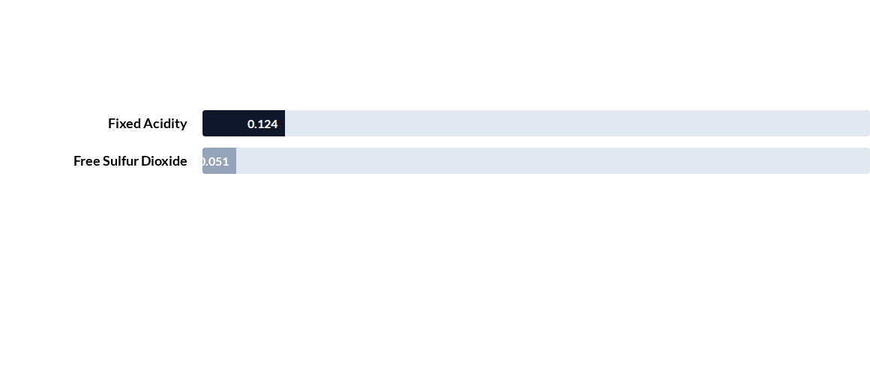
Q2: STATISTICAL CORRELATIONS
Correlation of acidity and sulfur dioxide with wine quality:
Fixed acidity shows a minor positive correlation, while free sulfur dioxide is slightly negative.

Slide 6
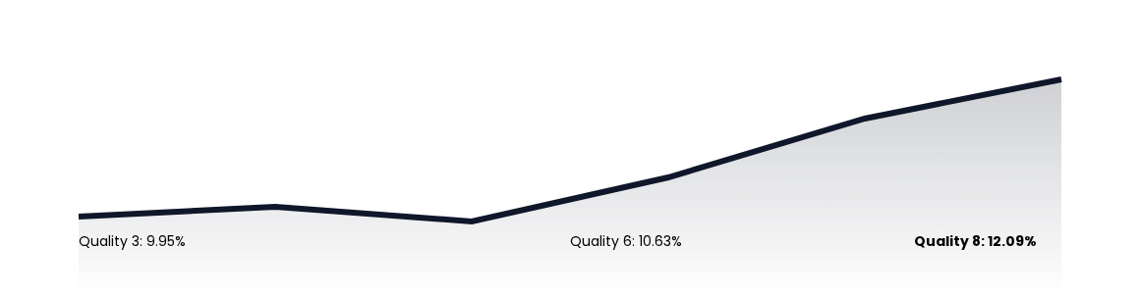
Q2: ALCOHOL VS. QUALITY
Trend analysis shows that higher average alcohol levels correlate with superior quality ratings:
Insight: Alcohol content is one of the most powerful predictors of premium wine classification.

Slide 7
Q3: RESIDUAL SUGAR ANALYSIS
Quality Rating | Avg Residual Sugar (g/L) | Trend Analysis
3 (Lowest) | 2.6350 | Higher than standard
5 (Median) | 2.5289 | Stable baseline
8 (Highest) | 2.5778 | Slightly elevated
Key Finding: Residual sugar remains relatively constant (~2.6 g/L) regardless of the wine quality score, indicating it is not a primary driver of grade.

Slide 8
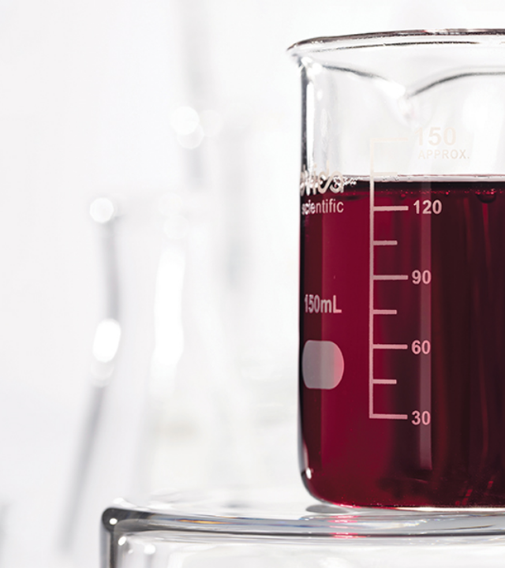

Q4: VOLATILE ACIDITY
The Negative Correlation
Volatile acidity exhibits a strong negative impact (-0.39) on overall quality perception.
Mean for Quality 3: 0.88
Mean for Quality 8: 0.42
Conclusion: Reducing volatile acidity is critical for moving from low-tier (3) to high-tier (8) quality classifications.

Slide 9
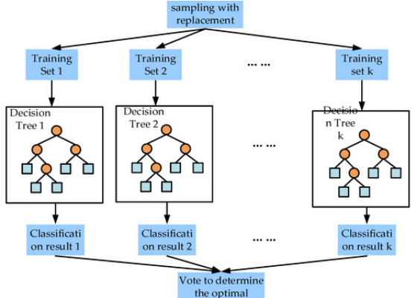
Q5: PREDICTIVE MODELING
Machine Learning Strategy
The dataset was split into Training (80%) and Testing (20%) sets to evaluate classification accuracy.
Decision Tree Classifier
Random Forest Ensemble

Slide 10
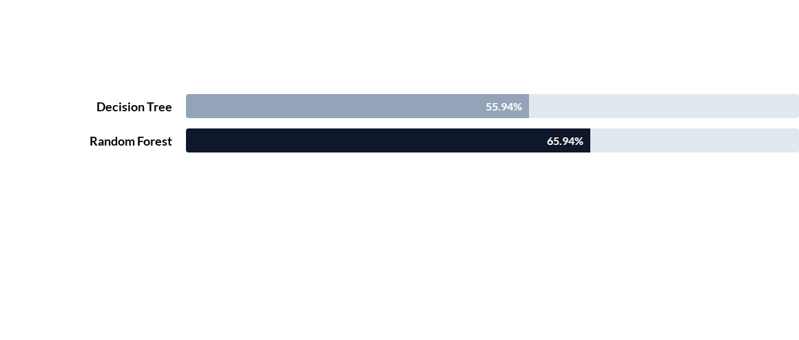


Q5: MODEL PERFORMANCE
Final comparison of predictive accuracy on the unseen test dataset:
The Random Forest model outperformed the baseline Decision Tree by 10%, highlighting the benefit of ensemble learning.
Training accuracy reached 98.8% for Random Forest, indicating high model capacity with appropriate depth limits.

Slide 11
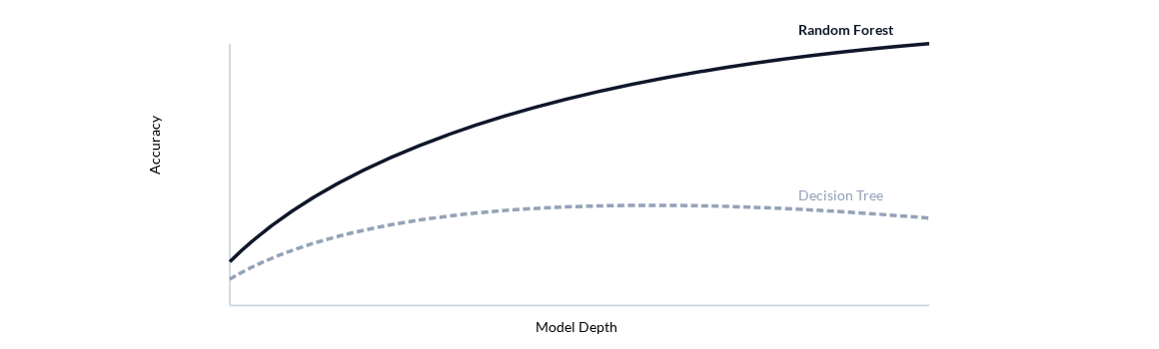
OPTIMIZATION: DEPTH VS. ACCURACY
Complexity Curve
Analysis of max_depth hyperparameter impacts on accuracy metrics:
Insight: Random Forest generalizes better at higher depths where single trees begin to overfit.

Slide 12

Analysis Summary
Alcohol and Volatile Acidity are primary quality predictors.
Residual Sugar has negligible impact on final grades.
Ensemble methods provide ~66% predictive accuracy.
Questions & Discussion

